Slide 1

Web Development 1
© Hugh McCabe & Matt Smith 2008-2015
Lecture 1b (THEORY)
An Introduction to Web Development

Slide 2
NOTE – update for 2015 …
Following feedback from past students towards the end of this semester we’ll get a gentle introduction to PHP (the server-side of web dev)
So while this module is mostly HTML and CSS, there is a ‘taster’ of PHP as well

Slide 3
What does a web designer do?

Slide 4
What does a web designer do?
Web-design
Catch-all phrase for complex process requiring different disciplines …
We can divide roles & responsibilities into 4 categories:
Design
Development
Content Strategy
Writing / collection text, images, videos etc.
Multimedia
In this module we’ll only be using still images

Slide 5
1.
DESIGN

Slide 6
What does a web designer do: DESIGN
No so much about looks
More about how site WORKS
Web site workings …
WHO are users of site
WHAT are their information goals / interaction goals
HOW does user know their current location in the site?
HOW can user find out how to get to where they need to?
DESIGN:
“UX” = the User Experience
To meet the (business) “objectives” of the website
Please do NOT talk about colour and fonts during your web project demo/defence …

Slide 7
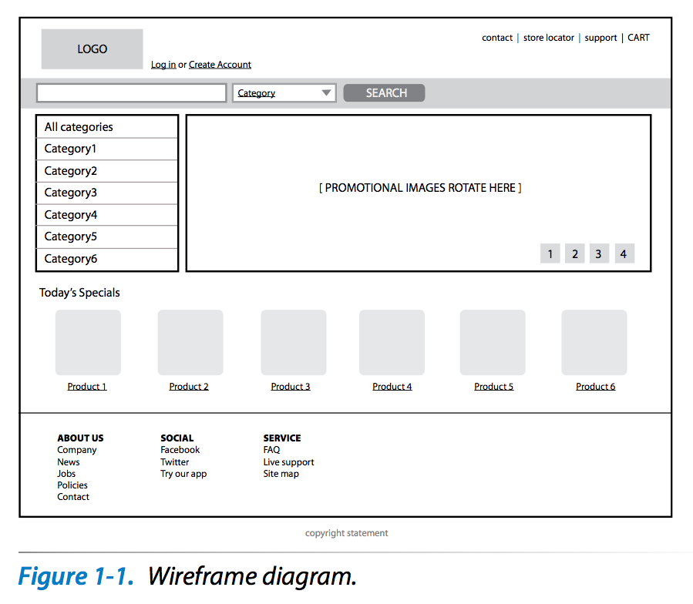

Slide 8
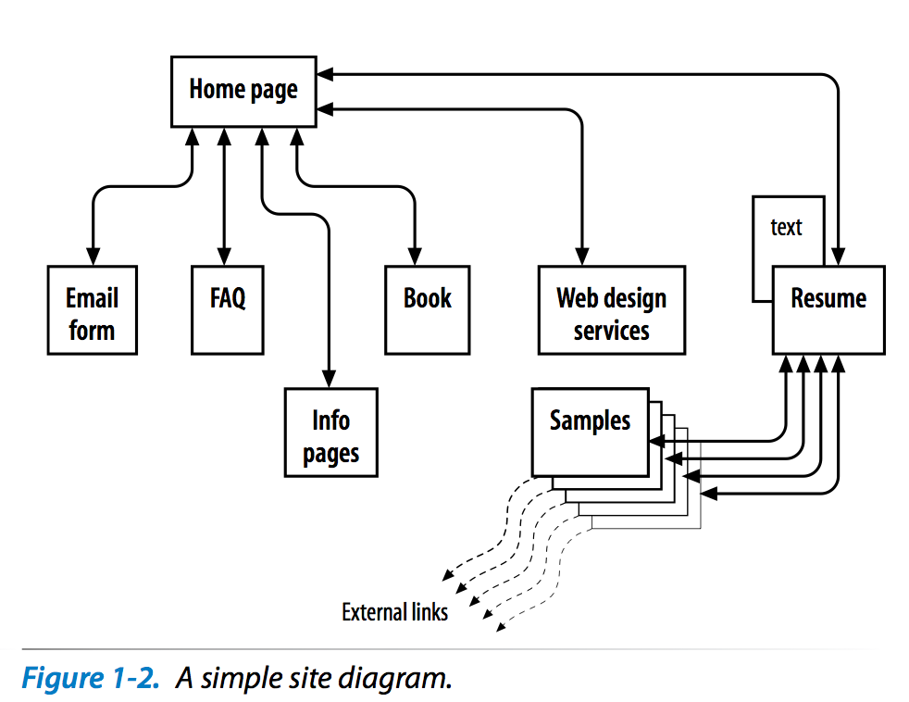

Slide 9
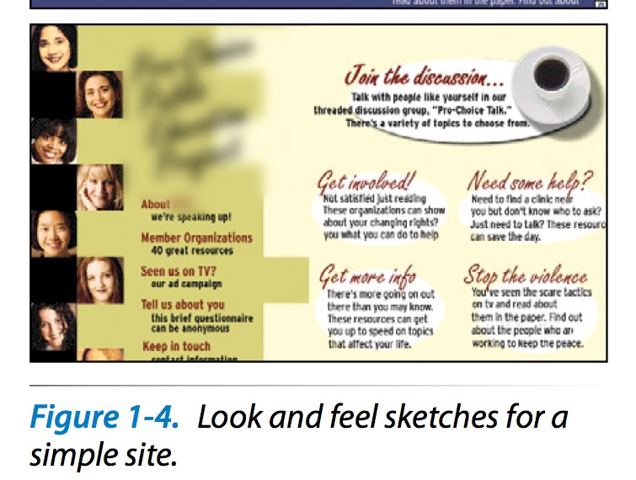
i.e. a web page ‘mockup’

Slide 10
2.
DEVELOPMENT
(what YOU are about to learn …)

Slide 11
What does a web designer do: DEVELOPMENT
Creating and troubleshooting (debugging):
Documents, Style sheets, Scripts, Images
This process called ‘development’ or ‘production’
Not necessary looking at the site as a whole
Implementing the designs they are given
Coding up the content and multimedia they are given
The WORKERS of the team …
HTML: Authoring/markup
CSS: Styling

Slide 12
DEVELOPMENT: Authoring / Markup
Authoring/markup
Preparing content for web delivery
I.e. ‘marking-up’ content using HTML ’tags’
E.g.
ITB home page
<title> ITB Home Page </title>

Slide 13
DEVELOPMENT: Styling
Styling
Writing style rules to determine appearance of content in browser
Rules are written in the CSS language
Cascading Style Sheets
Text file containing style rules called a CSS ‘style sheet’
Or sometimes a CSS ‘rule-set’

Slide 14
DEVELOPMENT: Scripting
SCRIPTING / PROGRAMMING
Interactivity requires writing in programming languages
Programming in web pages often referred to as ‘scripting’
Client-side (front end) = on the browser
JavaScript
Server-side (back-end) = on the server
Languages such as PHP, Java/JSP, .NET, Python etc.
You’ll learn JavaScript and PHP in other modules…

Slide 15
What languages do I need to learn?

Slide 16
Languages/Technologies for Web Development
So what technologies do you need to know about to develop web pages?
Here’s a list
We’ll only be learning the first 2 in this module...
HTML
CSS (Cascading Style Sheets)
Javascript/DOM scripting
Server-side programming

Slide 17
Technologies
1: HTML

Slide 18
Technologies for Web Development
HTML = HyperText Markup Language
the language used to create web page documents
HTML is not a programming language
It is a mark-up language
system for identifying and describing the various components of documents such as headings, paragraphs, list, web-links and so on
Everyone involved in Web Development needs at least a basic understanding of HTML

Slide 19
example of an HTML document
<!DOCTYPE html>
<html lang="en">
<head>
<meta charset="utf-8">
<title>Matt's web page</title>
</head>
<body>
<header>
<img src="images/matt.jpg" alt="picture of Matt">
</header>
<h1>Matt Smith</h1>
<p>
Matt is senior lecturer at ITB.
He is one of the Web Dev 1 lecturers this year.
</p>
<hr>
<footer>Copyright 2012</footer>
</body>
</html>

Slide 20
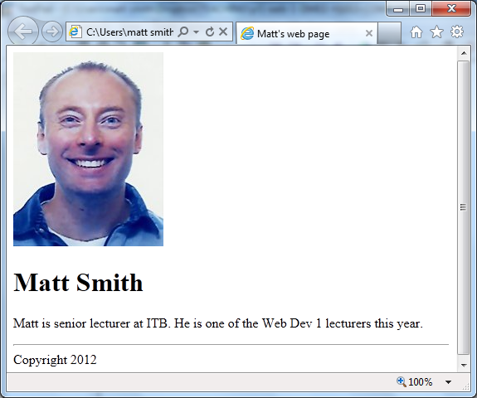

Slide 21
Technologies
2: CSS (Cascading Style Sheets)

Slide 22
Technologies for Web Development
2. CSS (Cascading Style Sheets)
HTML is used to describe the content of a web page.
CSS describe how you want that content to look.
This is called the presentation of the page.
A CSS document is called a style sheet.
CSS is powerful way to formatting text, arranging the page layout, and any other visual formatting that is necessary.

Slide 23
Technologies for Web Development
body {
background-color: yellow;
}
h1 {
color: green;
}
p {
font-size: small;
font-family: sans-serif;
}
header {
text-align: right;
}
Note USA ‘color’ spelling
The next slide shows you the result of applying this style sheet to the previous web page

Slide 24
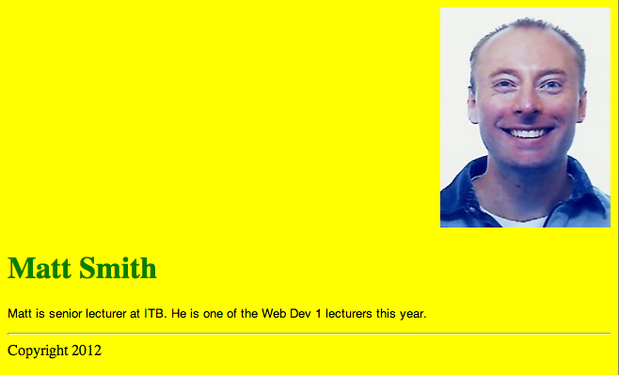

Slide 25
Technologies for Web Development
3. Javascript/DOM scripting
Used to add interactivity and behaviours to web pages.
Checking forms for valid entries
Swapping out styles for an element or an entire site
Making the browser remember information about the user
DOM – Document Object Model
- allows scripts to locate / change web page elements in the browser – interactive web pages – DYNAMIC …
See this with JQuery at (note: prices just for testing!)
http://www.mattsmithdev.com/estimator 229/estimator.php

Slide 26
Web Development “3-layer cake” – client side (in the web browser)
Javascript
CSS
HTML
Behaviour layer
Presentation layer
Structure layer

Slide 27
Technologies for Web Development
4. Server-side programming
Used to develop web applications
For example, shopping carts, databases, etc.
Languages such as PHP, JSP, .NET, Python, Perl …
Also – XML, Java, Flash ….
Web application (MVC) frameworks:
E.g. Symfony2, Zend
CMS (Content management system)
E.g. Wordpress
Server code ‘talks’ to server Database
E.g. MySQL, SQL Server, ORACLE

Slide 28
Web System – 3-tier system
Front-end (JS/CSS/HTML)
Business logic, e.g. PHP
Data, e.g. MySQL
Tier 1 = front end (presentation)
Tier 2 = Business logic/programming
Tier 3 = Data
Client side
e.g. browser
Server side

Slide 29
HTML and CSS – only these 2 in this module !!!!!
Front-end (JS/ CSS/HTML )
Business logic, e.g. PHP
Data, e.g. MySQL
Tier 1 = front end (presentation)
Tier 2 = Business logic/programming
Tier 3 = Data
Client side
e.g. browser
Server side

Slide 30
Summary and Conclusions

Slide 31
Summary / Conclusions … Web Development
combination of:
Design
Development / Production
Content Strategy
Multimedia: e.g. audio, video, animations, still images
Client side / Server Side
4 main technologies
HTML
CSS
JS/DOM scripting
Server side programming

Slide 32
The W3C and web standards
Learn about the international web standards body
The W3C
http://www.w3.org/
An article about them wen HTML5 was finalised
http://thenextweb.com/dd/2014/10/28/world-wide-web-consortium-finally-recommending-html5/
A video they published about the web and why standards are important
http://vimeo.com/110256895

